Slide 1
SWE30003
Software Architectures and Design
Lecture 1
Issues in Software Design
Notes:
SWE30003 Software Architectures and Design
S1 2023
© Swinburne University of Technology

Slide 2
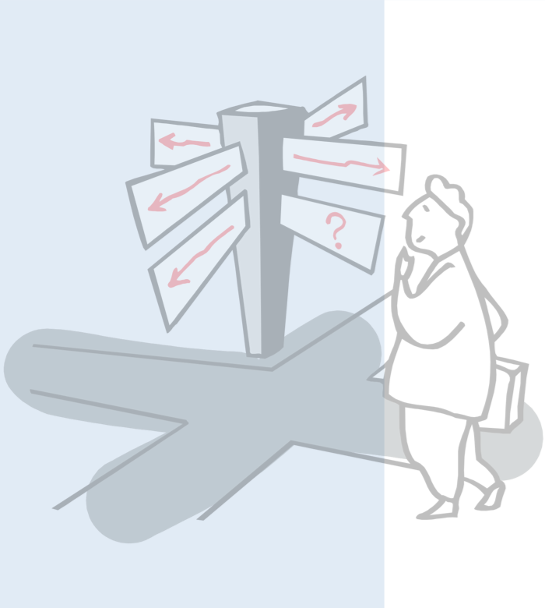
Outline
Unit of Study Overview
What Drives Software Development?
From Business Goals to Requirements
  Functional vs. Non-functional
  Verification & Validation
What is Design, what drives Design?
Notes:
SWE30003 Software Architectures and Design
S1 2023
© Swinburne University of Technology

Slide 3
Software Development Activities
Requirements Elicitation | Establish customer’s needs
Requirements Analysis | Model and specify the requirements (“what”)
Design | Model and specify a solution (“how”)
Implementation | Construct a solution in software
Testing | Verify the solution against the requirements
Maintenance | Repair defects and adapt the solution to new requirements
NB: these are ongoing activities, not sequential phases!
Notes:
SWE30003 Software Architectures and Design
S1 2023
© Swinburne University of Technology

Slide 4
Focus of Unit of Study
Requirements Elicitation | Establish customer’s needs
Requirements Analysis | Model and specify the requirements (“what”)
Design | Model and specify a solution (“how”)
Implementation | Construct a solution in software
Testing | Verify the solution against the requirements
Maintenance | Repair defects and adapt the solution to new requirements
Notes:
SWE30003 Software Architectures and Design
S1 2023
© Swinburne University of Technology
Note: the main focus will be on R&A and D, but Assignment 3 will do a “proof of concept” implementation of a design…

Slide 5
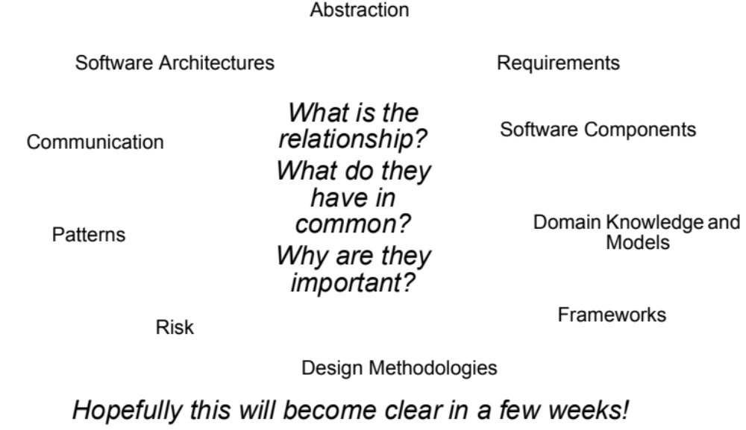
What we will be talking about…
Validation & Verification
Decomposition
Notes:
SWE30003 Software Architectures and Design
S1 2023
© Swinburne University of Technology
Explain here that the student should start creating a mental model for themselves – the links and relevance will become clear(er) over the next few weeks…

Slide 6
Outline
Unit of Study Overview
What Drives Software Development?
From Business Goals to Requirements
  Functional vs. Non-functional
  Verification & Validation
What is Design, what drives Design?
Notes:
SWE30003 Software Architectures and Design
S1 2023
© Swinburne University of Technology

Slide 7
Why do we build Software Systems?
To keep/retain customers
To increase customer base
To improve customer relationships
To improve productivity/efficiency (within organization/team)
Technology used no longer supported/outdated
Changes in environment (legal, social)
To achieve some “Business” Goals!
Notes:
SWE30003 Software Architectures and Design
S1 2023
© Swinburne University of Technology
There is always a “business” context in which software is developed.
If we talk about open source development, the business context may not always be that evident…

Slide 8
Categories of Business Goals
Business goals fall into five broad categories:
Reduce cost of ownership: development, maintenance, deployment, operation.
Improve the quality of the system(s) compared with its predecessors with respect to performance, modifiability, security, reliability etc.
Improve the capabilities/functionality offered by the system compared to its predecessors.
Improve organization’s market position.
Improve external confidence in either the organization or the system.
A particular system has generally more than one goal!
To address some “pain points”
Notes:
SWE30003 Software Architectures and Design
S1 2023
© Swinburne University of Technology
Source: Swinburne Presentation of Len Bass
Need to talk quite a bit about this…
Recapitulating pain points from SDP…

Slide 9
Views of Stakeholders
Many systems involve a variety of different stakeholders:
  Customers
  Developers
  Managers
  Users
All of them have different views and priorities
  May even lead to conflicting goals!
Development approaches must be able to cater for different views and priorities!
Notes:
SWE30003 Software Architectures and Design
S1 2023
© Swinburne University of Technology
Note: customers may not necessarily be the users of a system.
If customers think they know what the user wants (but are wrong), problems will inevitably occur.

Slide 10
Business Goals (cont.)
Priority of goals need to be specified:
Some goals are “nice to have”, others “need to have”, some “absolutely critical”
Developers sometimes have to “push back” or make trade offs. Knowing priority gives insights.
Source of goals need be specified:
Some goals are inherent to the system being developed
Some goals are a result of market analysis
Some goals are arbitrary - could cause problems!
Notes:
SWE30003 Software Architectures and Design
S1 2023
© Swinburne University of Technology
Talk about what arbitrary goals are… and where they come from…

Slide 11
Outline
Unit of Study Overview
What Drives Software Development?
From Business Goals to Requirements
  Functional vs. Non-functional
  Verification & Validation
What is Design, what drives Design?
Notes:
SWE30003 Software Architectures and Design
S1 2023
© Swinburne University of Technology

Slide 12
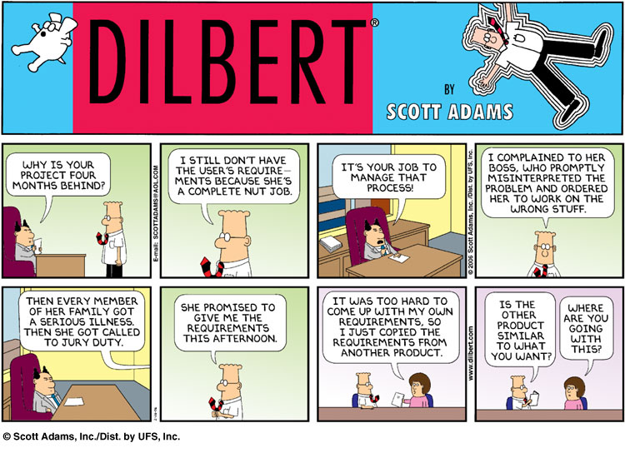
http://en.wikipedia.org/wiki/Fair_use
Notes:
SWE30003 Software Architectures and Design
S1 2023
© Swinburne University of Technology

Slide 13
Outline
Unit of Study Overview
What Drives Software Development?
From Business Goals to Requirements
  Functional vs. Non-functional
  Verification & Validation
What is Design, what drives Design?
Notes:
SWE30003 Software Architectures and Design
S1 2023
© Swinburne University of Technology

Slide 14
Functional and Non-functional Requirements
Functional requirements describe system services or functions
  Compute sales tax on a purchase
  Update the database on the server ...
  In essence, anything that can be directly expressed in code…
Non-functional requirements (also known as quality requirements) are constraints on the services and/or the development process
  “Reducing cost of deployment” cannot be directly expressed in code…
Domain requirements stem from the application domain of a system
  may be functional or non-functional
Notes:
SWE30003 Software Architectures and Design
S1 2023
© Swinburne University of Technology
Note: we may also talk about financial and time issues here…
Another aspect worth mentioning is ‘engagement’ of users – hard to define and even harder to measure…

Slide 15
Non-functional Requirements
Product requirements: | specify that the delivered product must behave in a particular way e.g. execution speed, reliability, etc.
Organizational requirements: | are a consequence of organizational policies and procedures e.g. process standards used, implementation requirements, etc.
External requirements: | arise from factors which are external to the system and its development process e.g. interoperability requirements, legislative requirements, etc.
Notes:
SWE30003 Software Architectures and Design
S1 2023
© Swinburne University of Technology

Slide 16
Examples of Non-functional Requirements
Product requirement | It shall be possible for all communication between the console and the user to be expressed in the standard ASCII character set.
Organisational requirement | The system development process and deliverable documents shall conform to the process and deliverables defined in XYZCo-SP-STAN-95.
External requirement | The system shall provide facilities that allow any user to check if personal data is maintained on the system. A process must be defined and supported in the software that will allow users to inspect personal data and to correct any errors in that data.
We will talk more about non-functional requirements in Week 3
Notes:
SWE30003 Software Architectures and Design
S1 2023
© Swinburne University of Technology

Slide 17
Outline
Unit of Study Overview
What Drives Software Development?
From Business Goals to Requirements
  Functional vs. Non-functional
  Verification & Validation
What is Design, what drives Design?
Notes:
SWE30003 Software Architectures and Design
S1 2023
© Swinburne University of Technology

Slide 18
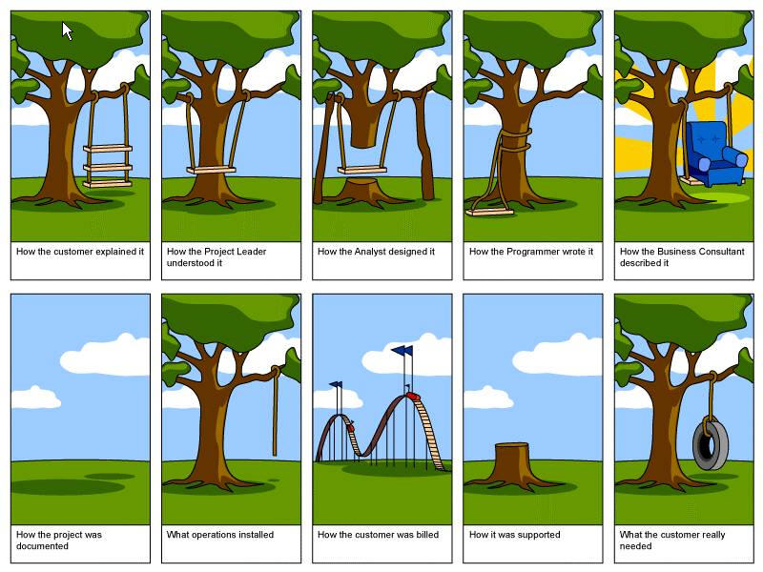
Impedance Mismatches
Notes:
SWE30003 Software Architectures and Design
S1 2023
© Swinburne University of Technology
There is a LOT of truth to this cartoon…

Slide 19
Verification and Validation
Verification:
Are we building the product right?
  i.e., does it conform to the specification(s)?
Validation:
Are we building the right product?
  i.e., does it meet stakeholders’ expectations?
Notes:
SWE30003 Software Architectures and Design
S1 2023
© Swinburne University of Technology
— Boehm (1979)

Slide 20
Requirements Verifiability
Requirements must be written so that they can be validated and objectively verified.
Imprecise:
  “The system should be easy to use by experienced controllers and should be organized in such a way that user errors are minimized.”
  Terms like “easy to use” and “errors shall be minimized” are useless as specifications as they are too vague.
Verifiable:
  “Experienced controllers should be able to use all the system functions after a total of two hours training. After this training, the average number of errors made by experienced users should not exceed two per day.”
You will hear a lot about requirements verifiability throughout the semester!
Notes:
SWE30003 Software Architectures and Design
S1 2023
© Swinburne University of Technology
It is rarely easy to write down quality requirements in a very precise, hence verifiable way…

Slide 21
Outline
Unit of Study Overview
What Drives Software Development?
From Business Goals to Requirements
  Functional vs. Non-functional
  Verification & Validation
What is Design, what drives Design?
Notes:
SWE30003 Software Architectures and Design
S1 2023
© Swinburne University of Technology

Slide 22
Software Design – a “Definition”
“Software design is the activity of drawing UML class diagrams once a software system has been coded in order to satisfy the requirements of unit conveners.”
Would you trust the software of an air-traffic control system that was implemented without prior structural analysis etc.?
Notes:
SWE30003 Software Architectures and Design
S1 2023
© Swinburne University of Technology

Slide 23
Design vs. Design
“Design is the creative process of transforming the problem into a solution. The description of the solution is also called the design.”
— Shari Lawrence Pfleeger, 1998
“The design of a system determines a set of components and inter-component interfaces that satisfy a specified set of requirements.”
— DeMarco, 1982
Activity
Artefact
Notes:
SWE30003 Software Architectures and Design
S1 2023
© Swinburne University of Technology
Design as an activity (process) vs. design as an end-result of this activity (artefact)
One should *DEFINITELY* add here that any design process should facilitate the development, not hinder it. “Facilitating” may not always be that bluntly obvious!!

Slide 24
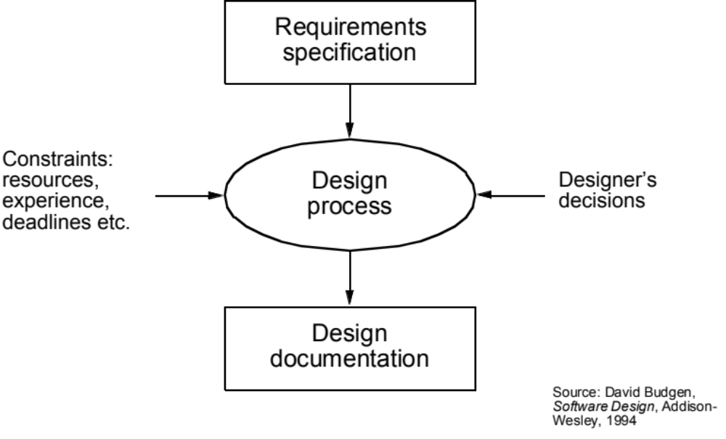
Design Process
Notes:
SWE30003 Software Architectures and Design
S1 2023
© Swinburne University of Technology
Again, there exist a multitude of notations to communicate design…

Slide 25
The Process of Decomposition
Decomposition is a process that helps to manage the complexity of a software system
  Starting with a high-level view of the system.
  Creating the low-level details of the features of the system in turn.
  Stop when we are satisfied with the level of detail.
  Also known as Divide-and-Conquer.
Notes:
SWE30003 Software Architectures and Design
S1 2023
© Swinburne University of Technology
One of the most fundamental approaches to software development…

Slide 26

Models
A model is a simplification of reality.
Models are created for better understanding of the problem, the domain, or the system to build.
A model can capture and represent,
  Structure (static model)
  Behavior (dynamic model)
Examples:
  Architectural blue-print of a house
  Hand-drawn screen (“wire-frame”)
  Class diagram
Notes:
SWE30003 Software Architectures and Design
S1 2023
© Swinburne University of Technology
A model is an abstraction of reality through which we want to reduce complexity. By approaching reality from a diversity of perspectives we can create a number of models that give us a better handle on the complexity of the problem. Every model gives us a semantic fixture on a part of the problem. Compare it to an architect making models before actually building the house he was commissioned to build. After a few rough sketches, a number of models are built that will give a better understanding of the lay out of the house and the use of all the different rooms. In the end models will be made that will show more practical details like, for instance, light fixtures, central heating and plumbing.

Slide 27
Q: What has a bigger impact on the design structure of a software system: functional requirements or quality requirements?
A: Quality requirements determine most structural design decisions, not functional requirements!
Notes:
SWE30003 Software Architectures and Design
S1 2023
© Swinburne University of Technology
I will need to give some “evidence” here why this is the case…
- Scability and distribution of “single-user” systems
- Increasing reliability from, say 95% to 99%, then to 99.9%

Slide 28
Quality-Driven Design
Quality requirements are those that drive the structural design of the software system.
Leads to several questions:
  How are quality requirements specified?
  How are quality requirements validated?
    This is also important for functional requirements!
  How are quality requirements achieved?
  How can understanding of the impact of quality attributes be used during the design process?
We will attempt to answer these questions over the next few weeks.
Notes:
SWE30003 Software Architectures and Design
S1 2023
© Swinburne University of Technology
Again, we will attempt to answer these questions over the next few weeks!

Slide 29

Forces in Software Projects
Time
Scope
Quality
Cost
Notes:
SWE30003 Software Architectures and Design
S1 2023
© Swinburne University of Technology
This slide needs A LOT of explanation - but is taken directly form SPPM!

Slide 30
Question to Answer Week 1
In your own words, characterize the difference between verification and validation and discuss where in the software development lifecycle (SDLC) verification and validation activities should be conducted, respectively.
Notes:
SWE30003 Software Architectures and Design
S1 2023
© Swinburne University of Technology

Slide 31
Catch-up Reading Lecture 1
Len Bass, Paul Clements, Rick Kazman, Software Architecture in Practice (2nd Edition), Addison-Wesley, 2003, Chapter 1 (available electronically through the Swinburne Library)
Notes:
SWE30003 Software Architectures and Design
S1 2023
© Swinburne University of Technology

Slide 32
Required Pre-Reading for Lecture 2
Soren Lauesen, Task Descriptions as Functional Requirements, IEEE Software, March 2003. (on Canvas, under week 2)
Notes:
SWE30003 Software Architectures and Design
S1 2023
© Swinburne University of Technology

